Slide 1
A Player’s Guide to
Artumbria

Slide 3
A Brief History
Origins
The Noble Races (Humans, Elves and Dwarves) arrived in this land around 1000 years ago. Whether they arrived as refugees or colonists is not known, very little knowledge remains of the “Old World”. After an unknown period of time the first city was established- Cynesfolk, and became the seat of power for the new Artumbrian royal family. The royal line was Human but the kingdom included the Dwarves and Elves who lived harmoniously together. Time is measured in Artumbria from the founding of the kingdom.
After a few centuries the borders of Artumbria had been established and the Halfling and Gnome races partially integrated. The land was divided into Duchies, each ruled by a noble family, leaving the royal family to govern from Cynesfolk.
More concerning have been the attacks from monstrous creatures and races. Goblinoids, Knolls and Orcs are but some of the threats faced. However through it all the Artumbrian royal line has remained strong and each invasion has been dealt with. This has partially led to the belief that the royal family itself holds some magic power- perhaps divine- to protect the land and keep the peace. Whether true or not, the royal family has indeed been masterful at managing the noble families and creating strong ties of allegiance. After several centuries the six Grand Duchies were firmly entrenched and aided the kings in governing the land.
Middle History
The history of Artumbria has been peaceful and troubled in equal parts. Plagues, famines and natural disasters have afflicted it, as well as incursions from external forces. The steppe people of the west, the tribes of the icefields to the south and the unruly northern slavers have all, at times, troubled the kingdom.

Slide 4
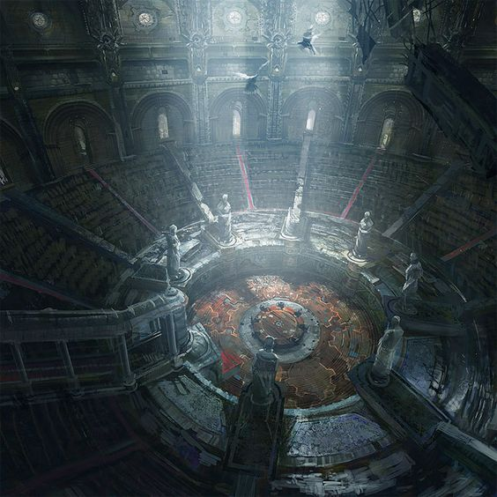
Recent History
The king’s sister, Eowalda was married to Lord Voclain, the Duke of Antaine (the most powerful of the Grand Duchies). He immediately pushed for Eowalda to be crowned as the new monarch. However instead it was agreed that a grand council would be held as soon as possible where all of the nobility in Artumbria would be gathered to debate the succession.
As of the year 988 since the founding of the kingdom, Artumbria was enjoying a period of relative peace. There was a young king on the throne, Aethelrun, and although he was only twenty, he had already ruled for several years and had become a favourite of the people. However, the royal family had gone through a period of low fertility and Aethelrun and his sister, Eowalda, were the only living members of the family remaining. While disconcerting, Aethelrun was a strong healthy young man and it was known he was seeing suitors and so the people were hopeful of a long reign producing many children.
However in the year 988 Aethelrun was murdered on his twentieth birthday. He was found in his copper bath tub, eyes gouged out, tongue removed, ears and nose hacked off and castrated. His death, and the horrific nature of it, caused outrage and despair. No killer was ever found. Even more worrying was the crisis of succession that it caused. Never in 988 years had the royal family been without a male heir. Whilst women could hold positions of power within the nobility, there had never been a queen before.
The Grand Council was held in Cynesfolk and was the largest event of its kind. Whilst all of the barons and earls of the land attended and debated for hours, all knew that it would be the six Grand Dukes who would ultimately decide. Averesch of Veentrecht was quick to declare his support for Eowalda’s claim. Voronin also seemed eager to declare his support. However Reinhold of Nebenhiem brought forth evidence to present to the council. He claimed that it was proof that the king had been murdered on the order of Voclain. There are mixed stories of exactly what the evidence was. Some claim it was as simple as Voclain’s signature on an assassin’s contract, others say it was correspondence between Voclain and Averecsh plotting to install Eowalda as a puppet ruler.

Slide 5
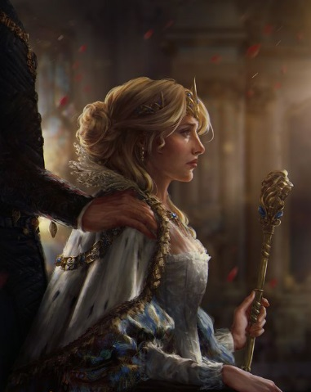
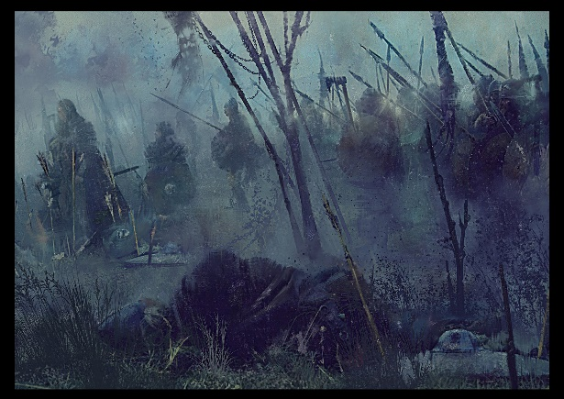
Wilder claims also existed saying the it was proof that Eowalda was not even a true Artumbrian and the conspiracy dated back to her mysterious birth. Whatever the evidence was, it proved enough to make Storen of Liervik refuse to support Eowalda and Voronin to change his mind. The Grand Council quickly grew out of hand as Voclain demanded Reinhold be arrested for treason and many minor nobles began to draw swords. Blood was spilt but each Duke was able to escape with their lives.
The next day Antaine had secured Cynesfolk and crowned Eowalda as Queen of Antaine with Veentrecht’s support. In response, Nebenheim, Soratov and Liervik formed the Confederacy of Duchies and declared themselves to be independent of the Kingdom of Artumbria. Antaine and Veentrecht decreed this illegal and began to mobilise their armies, the new Confederacy followed suit. Both sent emissaries to Chiavari, the remaining Duchy, to persuade Fiero to enter the war on their respective sides. However Fiero was reluctant to escalate the war and was more concerned with the external threats which would take advantage of this civil war.
The Current Situation Spring 991
The civil war has raged for three years and Artumbria is in a state of chaos. The capital of Soratov is currently besieged by Royalist forces and half the Duchy is in enemy hands. Nebenheim has sacked and burnt Veentrecht’s capital but at the cost of its best army. Liervik has gained ground in Antaine and is now fortified in the Fontenu Hills, but will not be able to hold out much longer. Both sides are near breaking point and are desperate for Chiavari to enter the war. Any intervention will almost certainly decide the war.
Meanwhile the common people suffer. Refugees, deserters, and opportunists roam the land turning to banditry. They are also facilitating the spread of a deadly plague whose victims die within days. There are too few men to bring in harvests and whole villages are being deserted. Law and order is breaking down as nobles and their men at arms fight on the frontlines. All of this chaos has led to a growth in incursions from monsters and beasts, exacerbating an already dire situation for Artumbria.

Slide 6
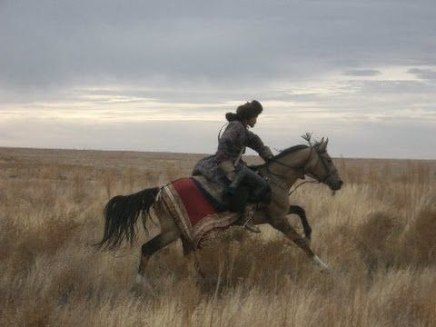
Borderland Regions
Dzungarian Steppe
To the West of Artumbria is a massive area of flat grasslands. Various tribes of horsemen live on the steppe. On several occasions these tribes have united under one leader and attacked Artumbria, with varying success. Usually they are too wild and disorderly to stay integrated for long and it is more common for small tribes to make raiding sorties into the kingdom. As well as raid, they also trade and are the major source of goods coming from the unknown lands to the West.
Artumbria is a kingdom surrounded by wildlands, scorching deserts, icefields and vast oceans. It is a sanctuary of civilisation within a continent of chaos.
Zagoran Desert
To the North-West the land becomes arid and eventually becomes a sand-dune desert. The Northern coastline has some habitable areas where traders and slavers make a living but few venture into the desert itself. Some talk of a tribe of Dwarfs known as the Ghelark, who live deep in the desert and trade exquisite glass, but none in Artumbria have ever seen them.
Markermeer Sea
Below the Dzungarian Steppe is the Markermeer Sea. This is an inland sea that goes off into the west. There are small fishing villages along some of its coast, however few venture far into the sea as there are said to be pirates and ginormous sea monsters.

Slide 7
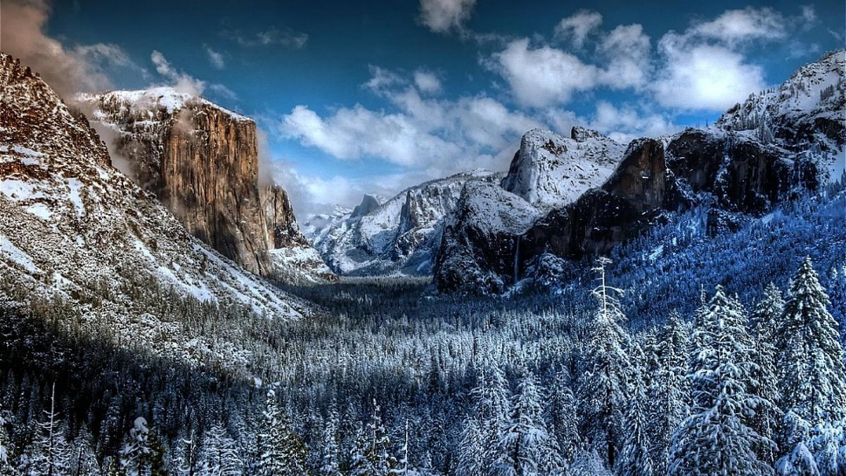
Usinsk Icefields
Sertsey
To the South of Artumbria are the Usinsk Icefields. The land varies between tundra and pine forests and is inhabited by a number of tribes. Some trade goods such as furs and timber, but relations are not generally friendly. Gradually the lands becomes uninhabited ice-sheets.
Sertsey is an island out in the Byssos Ocean. It is the homeland of the Dragonborn and is an independent nation from Artumbria. There is some trade between the two nations but the island is largely a mystery. It is said to be a volatile lands, both from the many active volcanoes on it, and the magical experiments carried out there.
Erendira
Erendira is a long peninsular that branches over the northern part of Artumbria. It is a barren land which is largely uninhabited. However along the coast are some small settlements which become more developed the further West they go, transferring into the Erendira Archipelago. Here there are large slave towns where pirates operate from.

Slide 8
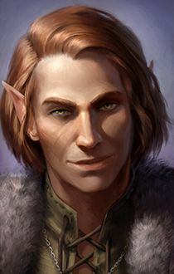
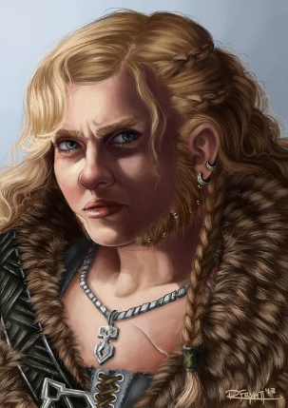
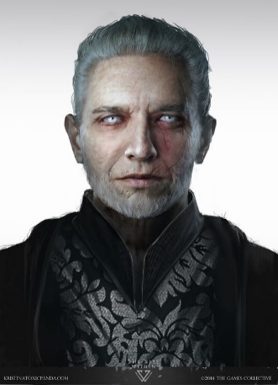
Races of Artumbria
Gnomes
Gnomes lived in the land that would become known as Artumbria long before the Noble Races arrived. Their origins are in the Fey. Lore amongst themselves dictates that they were originally born in the roots of Gnomora trees that existed in both the Fey and Material Worlds. The Noble Races enslaved the Gnomes for hundreds of years, using them as labourers and servants. Around a hundred years ago they were led by one amongst them, Tallara, in a successful revolution where they ended their state of bondage. Many returned to their previous traditions of subterranean and forest dwellings, but some remained amongst the Noble Races. Those that have tried to integrate find it hard to be treated as equal citizens in a society that had kept them in slavery for hundreds of years. Gnomes have a natural affinity for Fey magic and are generally of easy-going and kind temperament.
Humans, Elves and Dwarves
The three Noble Races, as they are known, first arrived almost a thousand years ago. It is unknown where they came from or why they left. Whether colonists or refugees, the three races founded Artumbria and have ruled it ever since. Each race retains some of its unique characteristics: Elves have a natural affinity for the arcane arts, Dwarves are great smiths and engineers, and Humans are great merchants and leaders. Generally the three races live together peacefully and Artumbria functions as in integrated kingdom. They are known as the Noble Races as they are the only ones who are permitted to own land.

Slide 9
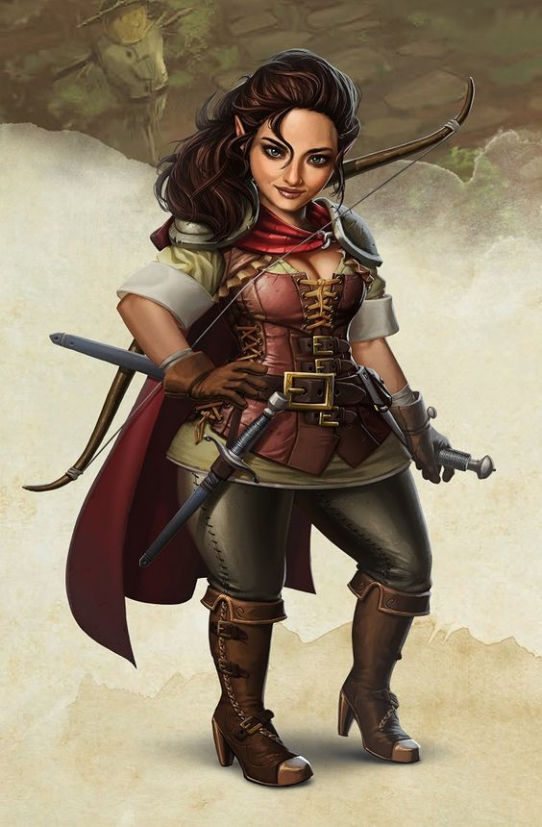
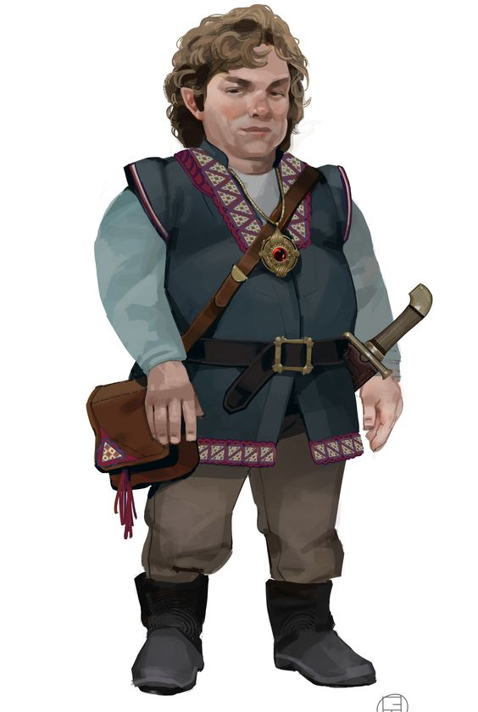
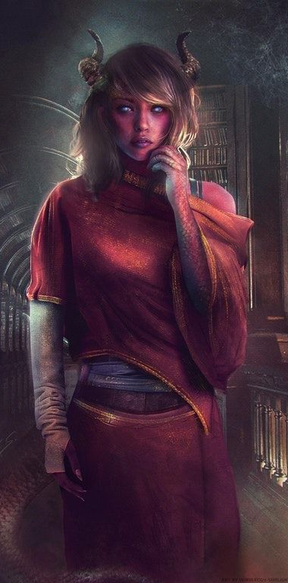
Halflings
Tieflings
Halflings have lived in Artumbria since before the Noble Races. Their origins are unclear and few bother themselves with pondering it. They built small communities along rivers and lived mostly as farmers. Once the Noble Races arrived and established vast cities, the Halflings flourished. Unlike the Gnomes, who were so alien to the Noble Races, the Halflings fit in with the new arrivals, and with Humans in particular. They proved adept as merchants and thrived in the rapidly expanding social and cultural melting pot. Some show interest in arcane studies, others adopted the Noble Races’ gods, but the majority live as merchants of some form or another. It is now very rare to find a homogenous Halfling community and the vast majority live fully integrated in the cities and towns.
Tieflings first began to be born after the Arcane Rift occurred in millennia past. They are only born to human parents and there seems to be little rhyme or reason to why a Tiefling is born the way it is. They are the result of an ancient battle where the Demon Realm attempted to pass over into the Material Realm and exist as a seemingly random mutation amongst humans. Their treatment varies depending of their families and the local population. Some Tieflings find themselves treated as an exotic oddities and can make a name for themselves amongst acting troupes, others can be hunted down and burnt at the stake. The common treatment is fear, disdain and prejudice. They often dwell in slum districts of cities, live as outcasts in the wild or travel to less civilised lands. Tieflings are unable to reproduce.

Slide 10
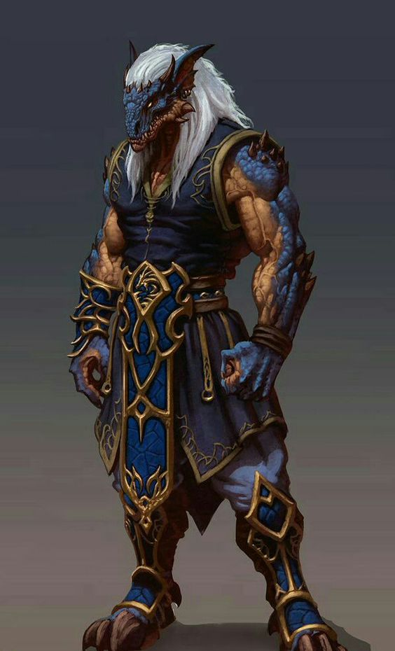
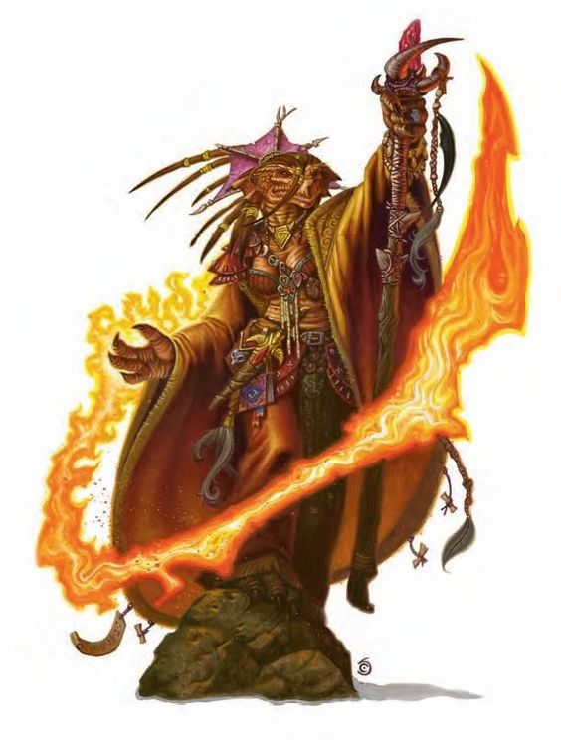
Dragonborn
Sundor Movement
Dragonborn entered the world around the time of the Arcane Rift, millennia ago. When the Demonic invasion began, dragons broke through into the Material Realm. Some say this is evidence of Dragons being Demons, others say the arrival was a by-product. Whatever the causes, Dragons were alien to the world. However, at some point Dragonborn began to be born from Dragon eggs. They believe themselves to be their god’s adaptation of Dragons for the Material Realm. In Artumbria, Dragonborn dwell on the independent island nation of Sertsey. They are intentionally isolated and few travel to the mainland. Those that do will be diplomats or magic users who are completing research and will not make permanent residence there.
The Sundor Movement had no exact origins, it evolved gradually throughout the history of the kingdom. It refers to Elves or Dwarves who have become disillusioned with the Artumbrian system of integrated Noble Races and want to live as segregated races. These groups vary in size and motivation. Some move to the most remote areas to live isolated lives, others actively campaign for others to join them. They are not explicitly outlawed but groups who grow too large or influential will be forcibly removed or arrested.
Some groups take their old heritage very literally and you will find a group of Sunder Elves living in woods or Sunder Dwarves establishing a mountain city. Their appeal and success has waxed and waned over the years, however the civil war has led to an increase in this movement as the authority and appeal of a homogenous society is breaking down.

Slide 11
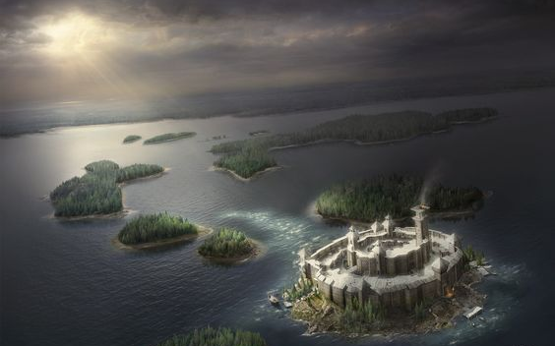
Religion
Worship
Most people consider the gods equal and will pray to them on particular occasions. For example if a daughter was born to a family, they would likely offer prayers to Byror and Gauzh. However people may feel an affinity for one of the gods in particular and keep idols of them in their home.
Shrines can be found throughout the world and may be dedicated to a specific god, or they may be a more general shrine. Here people can make offerings and pray. There are also temples which can be found in the hearts of cities, a small village or on a secluded mountain-top. What defines a temple is that priests must reside there. Priests lead services which people are allowed to partake in (but not required to) and they can take prayers from people with the intention of them being more powerful. Temples are funded purely by donation. There is no authority that runs the temples, and anyone can build them. Religion is in no way tied into politics.
Deities
The deities of Artumbria form a pantheon of gods who represent different aspects of the natural world. They are not overtly sentient with outward emotions and interests in the world, they are considered more to be inevitable forces of nature. Their existence is not considered to be a matter of debate, however the degree to which they intervene in everyday life is. The nine gods are:
Name | Aspects They Represent | Spirit Animal | Colour
Tarakhe | Chaos, Lies, Deceit | Fox | Brown
Tithemi | Order, Truth, Law | Owl | Purple
Byror | Life, Fertility, Growth | Horse | White
Daupus | Death, Corruption, Disease | Crow | Green
Heol | Light, the sun, hope | Eagle | Gold
Erebh | Darkness, the moon, despair | Bat | Black
Muzh | Masculinity, Fatherhood | Bull | Red
Gauzh | Femininity, Motherhood | Doe | Blue
Sciepan | Creator | None | None

Slide 12
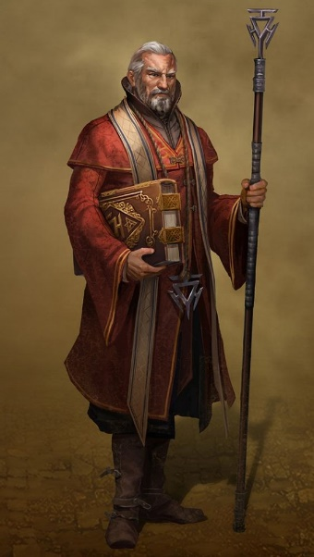
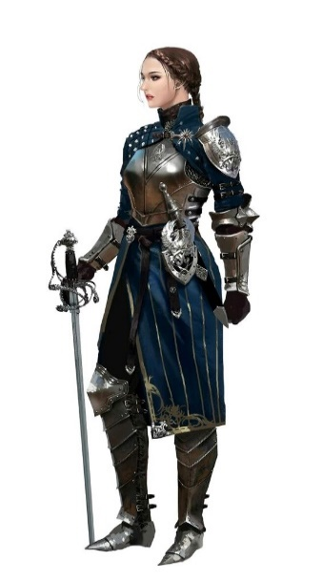
Although rarer, there are temples dedicated to individual gods. Occasionally this leads to an Order for certain gods, but these are loose organisations and only as formal as the members allow it to become. There have been cults created throughout history for individual gods, at times these have striven to raise their chosen god above the others, but these have rarely gained much power or popularity due to the breaking of the nature of the balance that rules the pantheon of gods.
The afterlife is believed to be a journey towards Elyvar, a realm where immortal souls reside in happiness and bliss. Getting to Elyvar is not definite. It is an arduous journey viewed almost like walking up a slope. Souls can fall down the slope and end up in the Abyss or the Nine Hells. Different peoples and races believe that different things in life can affect a soul’s ability to reach Elyvar. Some believe that prayer in life helps, others believe in sacrifices, some that fulfilling a divine calling in life can help. Equally some things are believed to hinder or damage one’s chances of reaching Elyvar, committing crimes for example.
Paladins and Clerics will focus on one of these gods to provide them with divine magic. As the gods are largely seen as forces of nature without emotion or motive, it is unknown why they favour some individuals and answers their calls over others. Sometimes a priest may dedicate their whole lives to a single god and only in their final years be granted access to divine magic. Other times a child who has never prayed in their lives and shows not interest in religion, will somehow be able to channel a deity. Many Clerics and Paladins follow a god but don't necessarily embody every aspect of them. It does not necessarily follow that a paladin of Daupus is “evil” nor that a follower of Heol is benevolent. Some divine magic users feel they do have a close personal relationship with their god, whilst others merely seem themselves as vessels to channel their power.

Slide 13
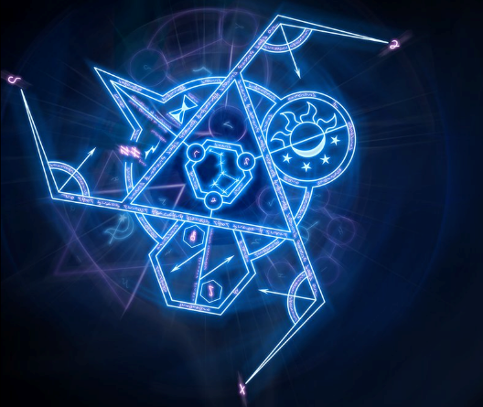
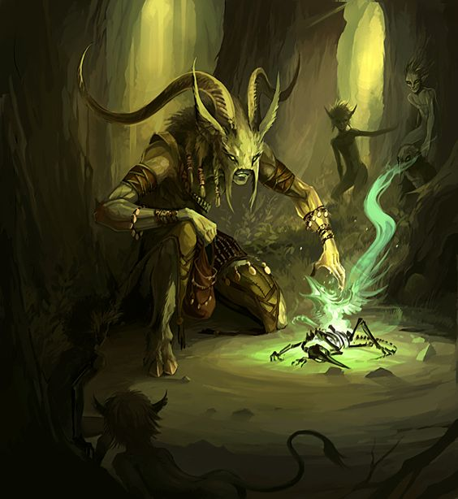
Magic
Magic users are rare in Artumbria, with perhaps one magic user for every thousand people. Some races are more likely to be able to learn magic (Elves) whilst others are more likely to be born with the ability (Dragonborn). There is also a higher likelihood of females amongst the races being able to access magic (a 2:1 ratio)
Arcane
Arcane magic is believed to have entered the world several millennia before during what is known as the Arcane Rift. This was an attempted invasion of Material Realms by demons who had torn away at the fabric of the world and forced their way through. Whilst the demons were eventually defeated, their holes and tears in the fabric of the world never fully healed and it was through these that the essence of magic seeped.
Arcane magic can be accessed in different ways. Some are able to learn to use magic through years of study (wizards) whilst others can be born with the ability and have no choice over whether to use it or not (sorcerers) whilst others make pacts with higher beings to access it (warlocks).
Fey
Many believe that during the Arcane Rift, the Material Realm was given aid by the Fey Realm in fighting off the demonic invasion. They too had once been invaded and wanted to halt the rising powers of the demons. Once they had willingly intervened in the Material Realm, a permanent connection was established. Some areas of the world are “closer” to the Fey and a greater number of Fey beings and magic will be observed. Some areas are even cross over points where the two Realms coexist. Druids, Rangers, some Warlocks and others can access the power of the Fey Realm.

Slide 14
House Rules
Races
Darkvision is not granted as an innate ability for any of the races. The ability can still be granted by magic means.
Languages: When the three Noble Races arrived in Artumbria they established Human as the Common language. Over the centuries Elvish and Dwarvish has fallen out of use and now only specialists who have studied them can read, write and speak in these languages. As such player characters do not know them except in special cases. The original language of the Halflings has been utterly lost as it was not a written language. Gnomish still exists and has thrived since their emancipation- all Gnomes speak Common and Gnomish. Dragonborn speak the languages Draconic and Common (although this may well be spoken only partially or with a particularly bad accent).
Whilst it is possible for different races to have sexual relationships, it is not possible for any combination to conceive offspring and therefore there are no half-elves or half-orcs.
General
On a critical hit the player rolls double the number of dice (not double their result).
Warlock’s automatically know their Patron Spells.
Alternative rules for Ranger can be discussed.
Potions can be drunk as a bonus action in combat, but a full action is required to administer to someone else.
When rolling for new hit points on a level up, the minimum a player can increase is half their hit die. For example a Fighter rolling a D10, get a 3, so instead they get 5 (plus CON modifier).

Slide 15
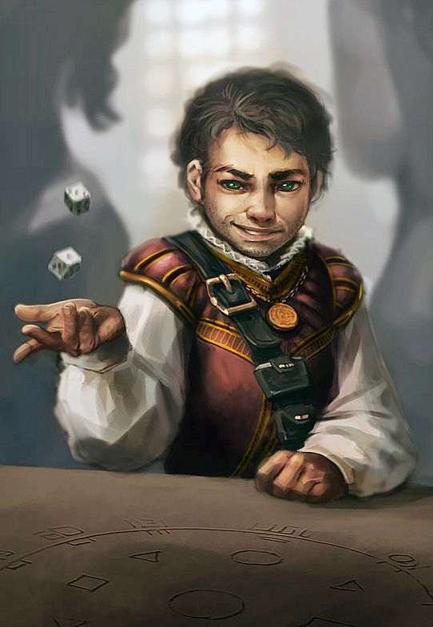
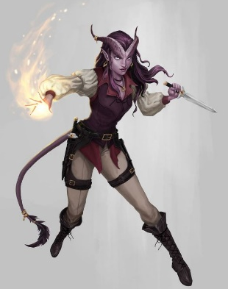
Feats
Critter Friend: Gnome- Increase your Wisdom score by 1, to a maximum of 20. Your friendship with animals is strong. You gain the following benefits: You gain proficiency in the Animal Handling skill. If you already have proficiency in it then it is doubled. You learn the Speak With Animals spell and can cast it at will without expending spell slots. You also learn the spell Animal Friendship spell which you can cast without using a spell slot. You regain the ability to cast the spell in this way when you finish a long rest. Wisdom is your spellcasting ability for these spells.
Demonic Visage: Tiefling- Increase your Charisma score by 1, to a maximum of 20. The demon blood flows strong in you. As a bonus action you can cause your appearance to change for one minute. Your appearance becomes more demonic for the duration (perhaps causing eyes to blaze, horns to lengthen, fangs to grow). For the duration of this effect you gain proficiency in the Intimidation skill. If you already have proficiency in that skill then it is doubled.
Racial Feats
Adaptability: Human- Increase your Intelligence score by 1, to a maximum of 20. You personify your race’s natural aptitude for hard work, innovation and leadership. You gain proficiency in any three skills of your choice.
Bountiful Luck: Halfling- Increase your Charisma score by 1, to a maximum of 20. You love company and can extend your luck to them. Whenever an ally you can see who is within 5 feet of you rolls a 1 on the d20 for an attack roll, an ability check, or a saving throw, you can use your reaction to let them reroll the die. The ally must use the new roll.

Slide 16
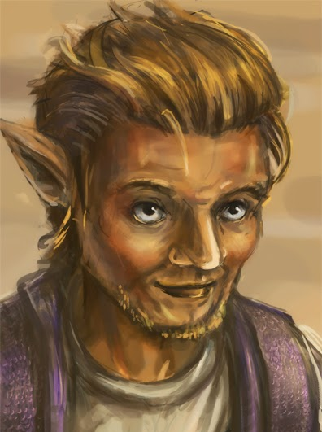
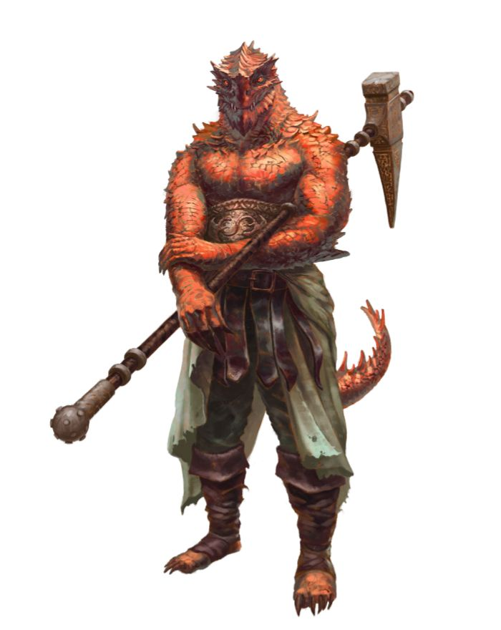
Draconic Hide: Dragonborn- Increase your Strength score by 1, to a maximum of 20. Your draconic ancestry is makes your body stronger and you gain the following benefits. Your tough scales give you plus 1 to your armour class. Additionally you also have retractable claws. Extending or retracting the claws requires no action. You can use them to make unarmed strikes. If you hit with them you deal slashing damage equal to 1d4 plus your strength modifier and counts as slashing damage rather than bludgeoning.
Expert Hagglers: Halfling- Increase your Charisma score by 1, to a maximum of 20. You love making a deal. You get to add your proficiency bonus to any skill check made which relates to agreeing on a price for something (likely to be persuasion or intimidation). If you already have proficiency in that skill then it is doubled.
Fade Away: Gnome- Increase your Wisdom score by 1, to a maximum of 20. You can draw on your magical inheritance when danger threatens. When you take damage you can use your reaction to turn invisible until the end of your next turn or until you attack, cause damage to someone or force someone to make a saving throw. You regain the use of this feature after a long rest.

Slide 17
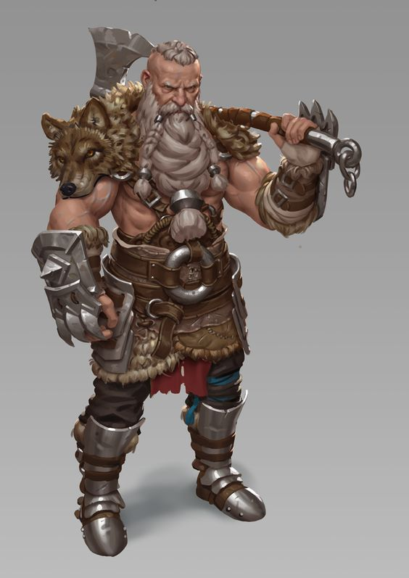
Flames of Hell: Tiefling- Increase your Constitution score by 1, to a maximum of 20. You can use your ancestry to access Hell itself. When you roll fire damage for a spell you cast, you can reroll any roll of 1 on the fire damage dice and must use the new roll. Whenever you cast a spell that deals fire damage, you can cause flames to wreathe you until the end of your next turn. The flames don’t harm you or your possessions and they shed a bright light for 30 feet and dim light for an additional 30 feet. While the flames are present, any creature within 5 feet of you that hits you with a melee attack take 1d4 fire damage.
Grudge-Bearer: Dwarf- Increase your Wisdom score by 1, to a maximum of 20. You have a deep hatred of a particular kind of creature. Choose one of the following to bear your wrath: aberrations, beasts, celestials, constructs, dragons, elementals, fey, fiends, giants, monstrosities, oozes, plants or undead. Alternatively choose one race of humanoids (such as goblins or knolls). You gain the following benefits: During the first round of combat against your chosen grudge, you have advantage to attack them. When any of your chosen foe makes an opportunity attack against you, they do so with disadvantage. Whenever you make an Intelligence check to recall information about your foe you add your proficiency bonus if you are not already proficient, and if you are you double the bonus.
Hardy Resilience: Dwarf- Increase your Constitution score by 1, to a maximum of 20. You are hard to bring down in a fight. Whenever you take the Dodge action in combat, you can spend one Hit Die to heal yourself (providing you have one available). Roll the die, add your constitution modifier and regain hit points equal to the total.

Slide 18
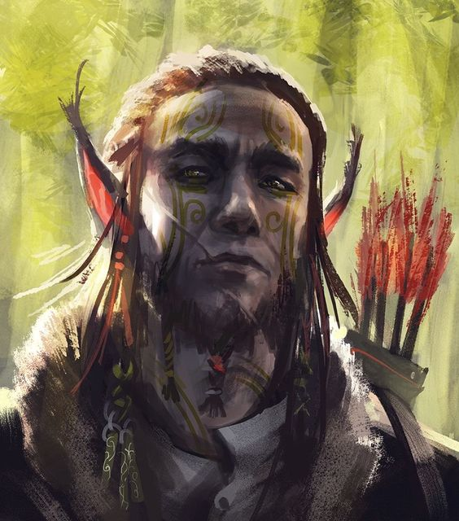
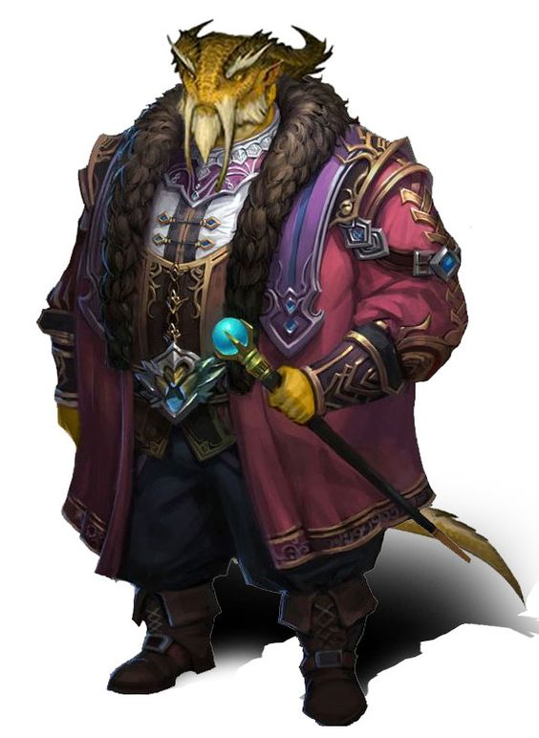
Knowledge of Magic: Dragonborn- Increase your Intelligence score by 1, to a maximum of 20. Your draconic ancestry grants you innate knowledge of the arcane. You gain proficiency in the Arcane skill. If you already have proficiency in that skill then it is doubled. You can also cast the spell Detect Magic without expending a spell slot. Intelligence is your spell casting ability for this spell. Perseverance: Human- You epitomise the Human’s determination of spirit. When you make an attack roll, skill check or a saving throw, you can do so with advantage. Once you use this ability you cannot do so again until you finish a short or long rest.
Remnants of Fey: Elf- Increase your Wisdom score by 1, to a maximum of 20. You are greatly attuned to your Fey ancestry and gain the following benefits. You learn one Druid cantrip of your choice. You also learn Longstrider and Pass Without Trace each of which you can cast without expending a spell slot. You regain the ability to cast the spell in this way when you finish a long rest. Wisdom is your spellcasting ability for these spells.
Superior Accuracy: Elf- Increase your Dexterity score by 1, to a maximum of 20. Your eyes and wits are supernaturally keen. When you have advantage on an attack roll you may reroll one of the dice once.

Slide 19
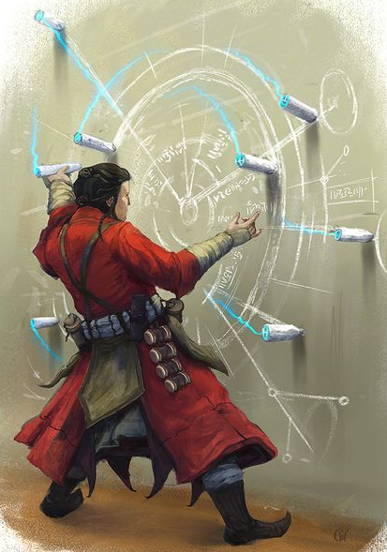
Skill Feats
Acrobat You become more nimble, gaining the following
benefits:
•You gain proficiency in the Acrobatics skill. If you are already proficient in the skill, you add double your proficiency bonus to checks you make with it.
•As a bonus action, you can make a DC 15 Acrobatics check. If you succeed, difficult terrain doesn’t cost you extra movement until the end of the current turn.
Animal Handler You master the techniques needed to train and handle animals. You gain the following benefits.
•You gain proficiency in the Animal Handling skill. If you are already proficient in the skill, you add double your proficiency bonus to checks you make with it.
•You can use a bonus action on your turn to command one friendly beast within 60 feet of you that can hear you and that isn’t currently following the command of someone else. You decide now what action the beast will take and
where it will move during its next turn, or you issue a general command that lasts for 1 minute, such as to guard a particular area.
Arcanist You study the arcane arts, gaining the following
benefits:
• You gain proficiency in the Arcana skill. If you are already proficient in the skill, you add double your proficiency bonus to checks you make with it.
•You learn the prestidigitation and detect magic spells. You can cast detect magic once without expending a spell slot, and you regain the ability to do so when you finish a long rest.

Slide 20
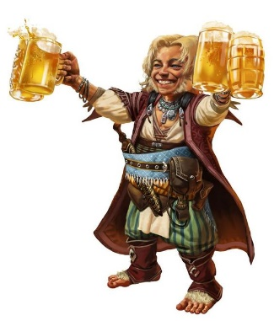
Brawny You become stronger, gaining the following benefits:
•You gain proficiency in the Athletics skill. If you are already proficient in the skill, you add double your proficiency bonus to checks you make with it.
•You count as if you were one size larger for the purpose of determining your carrying capacity.
Diplomat You master the arts of diplomacy, gaining the following benefits:
•You gain proficiency in the Persuasion skill. If you are already proficient in this skill, you add double your proficiency bonus to checks you make with it.
•If you spend 1 minute talking to someone who can understand what you say, you can make a Persuasion check contested by the creature’s Insight check. If you or your companions are fighting the creature, your check automatically fails. If your check succeeds, the target is charmed by you as long as it remains within 60 feet of you and for 1 minute thereafter.
Empathic You possess keen insight into how other people think and feel. You gain the following benefits:
•You gain proficiency in the Insight skill. If you are already proficient in the skill, you add double your proficiency bonus to checks you make with it.
•You can use your action to try to get uncanny insight about one humanoid you can see within 30 feet of you. Make a Insight check contested by the target’s Deception check. If your check succeeds, you have advantage on attack rolls and ability checks against the target until the end of your next turn.
Historian Your study of history rewards you with the following benefits:
•You gain proficiency in the History skill. If you are already proficient in the skill, you add double your proficiency bonus to checks you make with it.
•When you take the Help action to aid another creature’s ability check, you can make a DC 15 History check. On a success, that creature’s check gains a bonus equal to your proficiency bonus, as you share pertinent advice and historical examples. To receive this bonus, the creature must be able to understand what you’re saying.

Slide 21
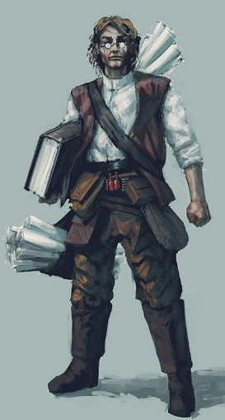
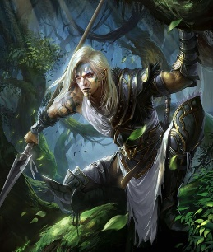
Investigator You have an eye for detail and can pick out the
smallest clues. You gain the following benefits:
•You gain proficiency in the Investigation skill. If you are already proficient in the skill, you add double your proficiency bonus to checks you make with it.
•You can take the Search action as a bonus action.
Medic
You master the physician’s arts, gaining the following benefits:
•You gain proficiency in the Medicine skill. If you are already proficient in the skill, you add double your proficiency bonus to checks you make with it.
•During a short rest, you can clean and bind the wounds of up to six willing beasts and humanoids. Make a DC 15 Medicine check for each creature. On a success, if a creature spends a Hit Die during this rest, that creature can forgo the roll and instead regain the maximum number of hit points the die can restore. A creature can do so only once per rest, regardless of how many Hit Dice it spends.
Menacing You become fearsome to others, gaining the following benefits:
•You gain proficiency in the Intimidation skill. If you are already proficient in the skill, you add double your proficiency bonus to checks you make with it.
•When you take the Attack action on your turn, you can replace one attack with an attempt to demoralize one humanoid you can see within 30 feet of you that can see and hear you. Make a Intimidation check contested by the target’s Insight check. If your check succeeds, the target is frightened until the end of your next turn. If your check fails, the target can’t be frightened by you in this way for 1 hour.
Naturalist Your extensive study of nature rewards you with the following benefits:
•You gain proficiency in the Nature skill. If you are already proficient in the skill, you add double your proficiency bonus to checks you make with it.
•You learn the druidcraft and detect poison and disease spells. You can cast detect poison and disease once without expending a spell slot, and you regain the ability to do so when you finish a long rest.

Slide 22
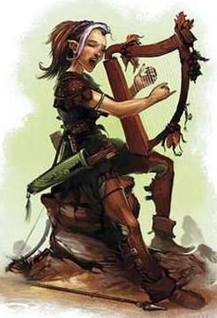
Perceptive You hone your senses until they become razor sharp. You gain the following benefits:
•You gain proficiency in the Perception skill. If you are already proficient in the skill, you add double your proficiency bonus to checks you make with it.
•Being in a lightly obscured area doesn’t impose disadvantage on your Perception checks if you can both see and hear.
Performer You master performance so that you can command any stage. You gain the following benefits:
•You gain proficiency in the Performance skill. If you are already proficient in the skill, you add double your proficiency bonus to checks you make with it.
•While performing, you can try to distract one humanoid you can see who can see and hear you. Make a Performance check
contested by the humanoid’s Insight check. If your check succeeds, you grab the humanoid’s attention enough that it makes Perception Investigation checks with disadvantage until
you stop performing.
Quick Fingered Your nimble fingers and agility let you perform
sleight of hand. You gain the following benefits:
•You gain proficiency in the Sleight of Hand skill. If you are already proficient in the skill, you add double your proficiency bonus to checks you make with it.
•As a bonus action, you can make a Sleight of Hand check to plant something on someone else, conceal an object on a creature, lift a purse, or take something from a pocket.
Silver Tongued You develop your conversational skill to better
deceive others. You gain the following benefits:
•You gain proficiency in the Deception skill. If you are already proficient in the skill, you add double your proficiency bonus to checks you make with it.
•When you take the Attack action on your turn, you can replace one attack with an attempt to deceive one humanoid you can see within 30 feet of you that can see and hear you. Make a Deception check contested by the target’s Insight check. If your check succeeds, your movement doesn’t provoke
opportunity attacks from the target and your attack rolls against it have advantage; both benefits last until the end of your next turn or until you use this ability on a different target. If your check fails, the target can’t be deceived by you in this way for 1 hour.

Slide 23
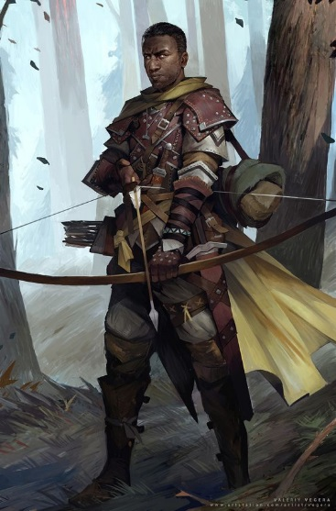
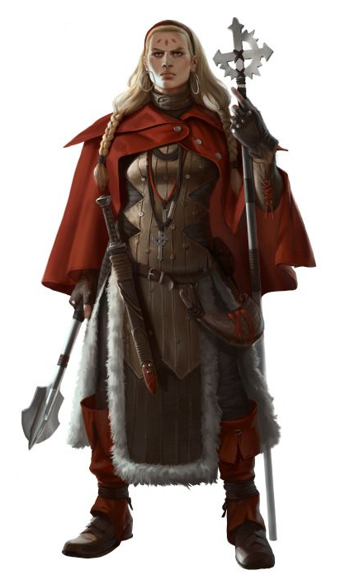
Stealthy You know how best to hide. You gain the following benefits:
•You gain proficiency in the Stealth skill. If you are already proficient in the skill, you add double your proficiency bonus to checks you make with it.
•If you are hidden, you can move up to 10 feet in the open without revealing yourself if you end the move in a position where you’re not clearly visible.
Survivalist You master wilderness lore, gaining the following benefits:
•You gain proficiency in the Survival skill. If you are already proficient in the skill, you add double your proficiency bonus to checks you make with it.
•You learn the alarm spell. You can cast it once without expending a spell slot, and you regain the ability to do so when you finish a long rest.
Theologian Your extensive study of religion rewards you with the following benefits:
•You gain proficiency in the Religion skill. If you are already proficient in the skill, you add double your proficiency bonus to checks you make with it.
•You learn the thaumaturgy and detect evil and
good spells. You can cast detect evil and good once without expending a spell slot, and you regain the ability to do so when you finish a long rest.

